Slide 1
Web Design & Development Y2/Sem 1
Week 6. Accessibility

Slide 2
Topics
What is Web accessibility?
WCAG (Web Content Accessibility Guidelines)
Design basics for web accessibility
ARIA (Accessible Rich Internet Applications)
Inclusive Design, Universal design, Universal design for learning (UDL)

Slide 3
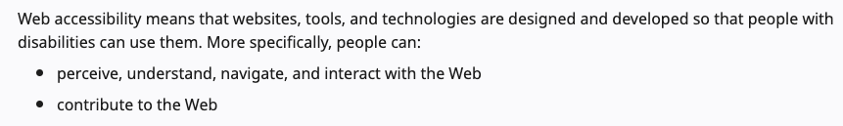
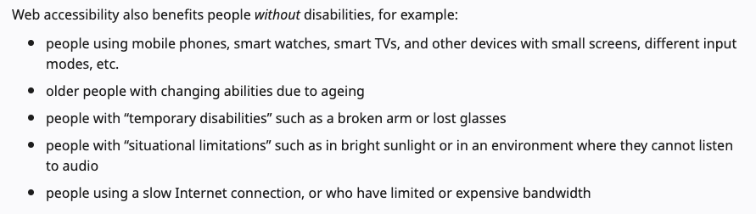
What is Web Accessibility?*
*Taken from W3C

Slide 4
Screen reading technologies
Desktop
NVDA - open source for Windows
Narrator - Windows
Voiceover - OSX, iPad
JAWS - commercial package
Web
browsealoud.com
Browsers
various extensions

Slide 5
WCAG 2.1
Web Content Accessibility Guidelines (WCAG) 2.1 defines how to make Web content more accessible to people with disabilities.
Four principles of Accessibility
Perceivable – information and UI components must be presentable to users in ways they can perceive
Operable – users must be able to operate the interface
Understandable – users must be able to understand the information as well as the operation of the UI
Robust – users must be able to access the content with current and future assistive technologies
EU directive states that public sector bodies should have conformed with WCAG2.1 Level AA by 2020

Slide 6
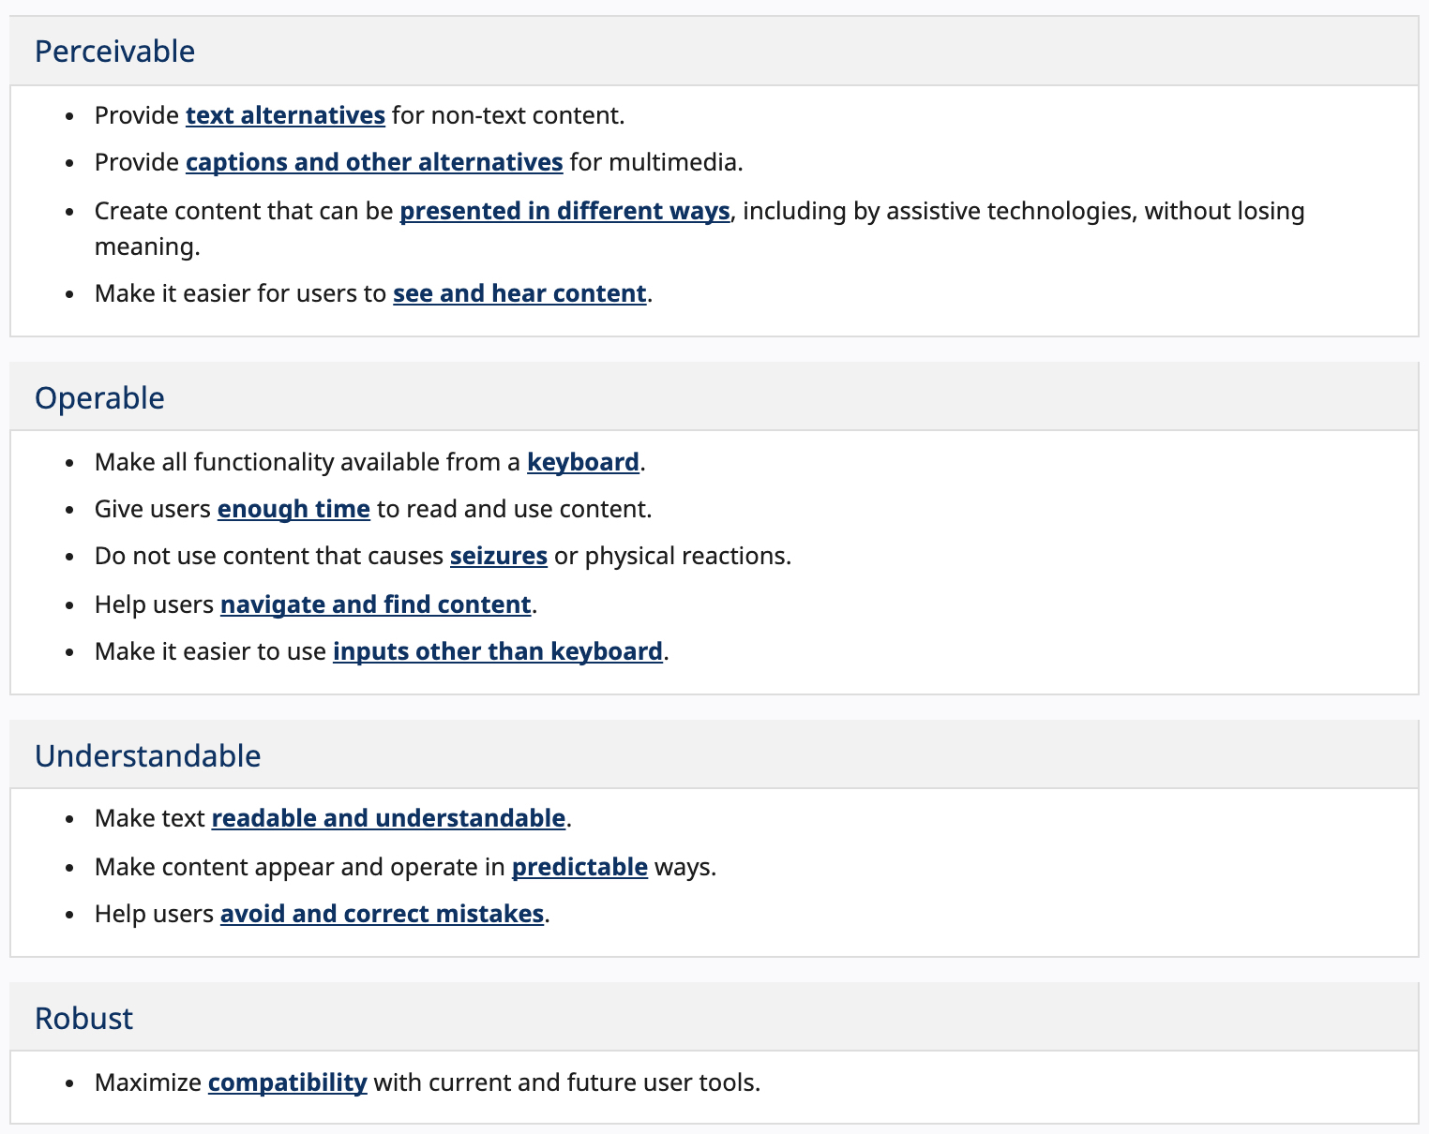

Slide 7
WCAG Audience
Web content developers (page authors, site designers, etc.)
Web authoring tool developers
Web accessibility evaluation tool developers
Others who want or need a standard for web accessibility, including for mobile accessibility

Slide 8
WCAG 2.1 & Conformance Levels
Conformance Level: One of the following levels of conformance is met in full
Level A
For Level A conformance (the minimum level of conformance), the Web page satisfies all the Level A Success Criteria, or a conforming alternate version is provided.
Level AA
For Level AA conformance, the Web page satisfies all the Level A and Level AA Success Criteria, or a Level AA conforming alternate version is provided.
Level AAA
For Level AAA conformance, the Web page satisfies all the Level A, Level AA and Level AAA Success Criteria, or a Level AAA conforming alternate version is provided.

Slide 9
Examples of Conformance
Perceivable - 1.1.1 Non-text Content (Level A)
All non-text content that is presented to the user has a text alternative that serves the equivalent purpose, except for.....
Operable – 2.1.1 Keyboard (Level A)
All functionality of the content is operable through a keyboard interface without requiring specific timings for individual keystrokes, except where the underlying function requires input that depends on the path of the user's movement and not just the endpoints.
Understandable – 3.1.1 Language of a Page (Level A)
The default human language of each Web page can be programmatically determined.
Robust – 4.1.1 Parsing (Level A)
In content implemented using markup languages, elements have complete start and end tags, elements are nested according to their specifications, elements do not contain duplicate attributes, and any IDs are unique, except where the specifications allow these features.

Slide 10
Examples of Conformance
Perceivable – 1.4.4 Resize text (Level AA)
Except for captions and images of text, text can be resized without assistive technology up to 200 percent without loss of content or functionality.
Operable – 2.4.6. Headings and Labels (Level AA)
Headings and labels describe topic or purpose.
Understandable - 3.2.3 Consistent Navigation (Level AA)
Navigational mechanisms that are repeated on multiple Web pages within a set of Web pages occur in the same relative order each time they are repeated, unless a change is initiated by the user.

Slide 11
General Design Basics for Accessibility
Consistency - look, colours, navigation & links, content & tone
Enhance clarity - images, colour, space (good design)
Avoid colour alone (e.g. for forms use * for required fields)
Contrast between background & foreground
Avoid flash, flicker, unnecessary animation
Consider how multimedia is used

Slide 12
Technical Design Basics for Accessibility
Avoid frames
Use Javascript wisely (e.g does user know that part of page has changed?)
Avoid popups (but if used should be smaller, have title, close option).
Avoid auto-refresh, auto-redirect pages

Slide 13
Navigation, site traversal
Consistent, expected navigation
Consider site search, site map, breadcrumbs.
Long pages - anchor links + back to top.
Make links ‘readable’ - avoid ‘click here’, ‘download here’ etc. use title attribute for tooltip
Use logical tab order (use tabindex attribute)

Slide 14
Content
Write clearly and concisely
Short sentences and paragraphs
Prioritise information (inverted pyramid, visitors scanning most of the time) and present it clearly (avoid bold, italics, all caps)

Slide 15
HTML code & Accessibility
Language declaration (e.g <html lang=‘en’>), lang attribute can also be used on other page elements (div, span, p, etc)
Page title & basic metadata (<title>, <meta name=“description” content=“”>
Page Headings (h1..h6 - avoid skipping)
Define and use lists properly (ul, ol) – all navigation will be lists
Avoid absolute units (e.g. px)

Slide 16

Images
Use the alt attribute if relevant (e.g. graphic of phone number but not with image providing ‘eye candy’)
Avoid use of images to display text
In this example, alt text is same as caption
More correct alt text
EU Brexit negotiator Michel Barnier speaking to the media in Brussels, Photograph: Getty

Slide 17
Forms
Good form layout = good for user conversion
Think carefully about the detail you wish to gather (why do I need this information?)
Always use labels (<label> provides description of the field to the user)
Group similar items and order logically (use <fieldset> and <legend> elements
Dropdown vs radio buttons?

Slide 18
ARIA – Accessible Rich Internet Applications
ARIA is markup that allows us to communicate important semantics when the native HTML cannot.
ARIA allows web content and internet applications to be more usable. Conveys extra information to screen readers parsing/reading through a web application.
Allows JavaScript to communicate dynamic changes in roles, states and relations to assistive technologies.
The author gives information about site so flow and focus are detectable.
ARIA attributes can be added to existing HTML5 elements.

Slide 19
ARIA – Roles, Properties, States
Roles
Provide semantic meaning to content
<input type=‘radio’> is radio role, <input type=‘checkbox’> is checkbox and so on..
<div> and <span> have no semantic role unless added <div role=”navigation” (see all of the ARIA roles)
Roles – the purpose of an element
Widgets – button, checkbox, slider, textbox
Composite – select/combo box, grid
Document Structure – table, article, cell, list
Landmark – banner, form, search, navigation

Slide 20
ARIA – Roles, Properties, States
Properties – what an element can do
States – how the element can change
Best Practice : Developers should always prefer using the correct existing semantic HTML element over using ARIA. Where this is not possible then use ARIA Roles.

Slide 21
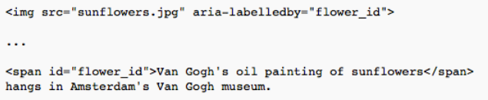
ARIA - Property/State examples
aria-label /aria-labelledby: define a string that labels the current element
aria-label used if not possible to have a visible label text on screen
aria-labelledby used if label text visible on screen

Slide 22
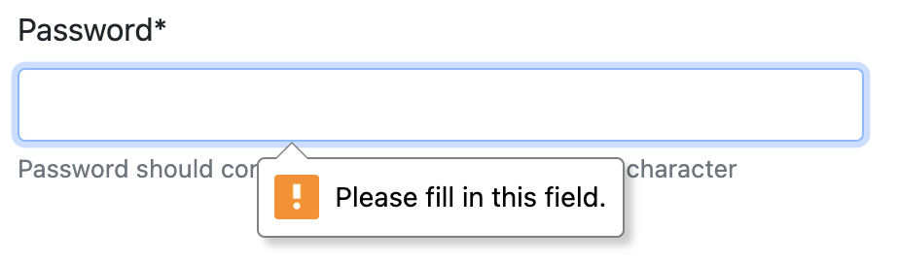
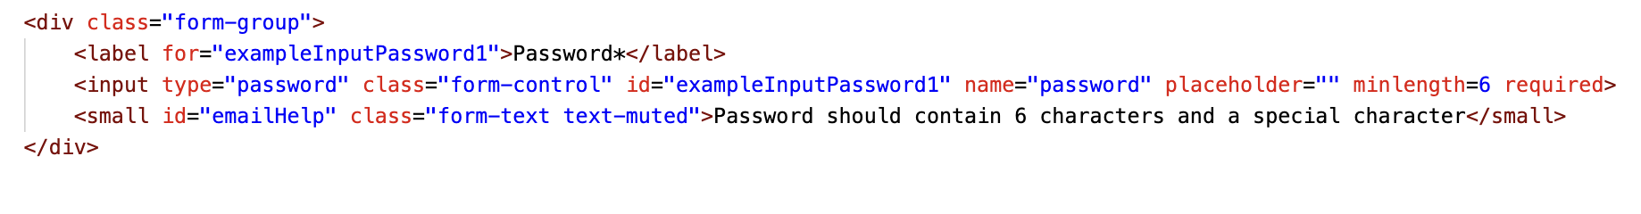
ARIA - Property/State examples
aria-required / required- used to indicate to the use that an input element is required for form submission
required - HTML5 attribute

Slide 23
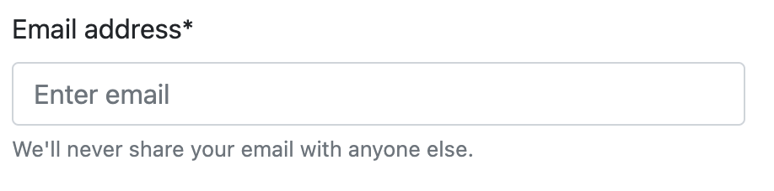
ARIA - Property/State examples
aria-describedby - provides additional information (apart from label)

Slide 24
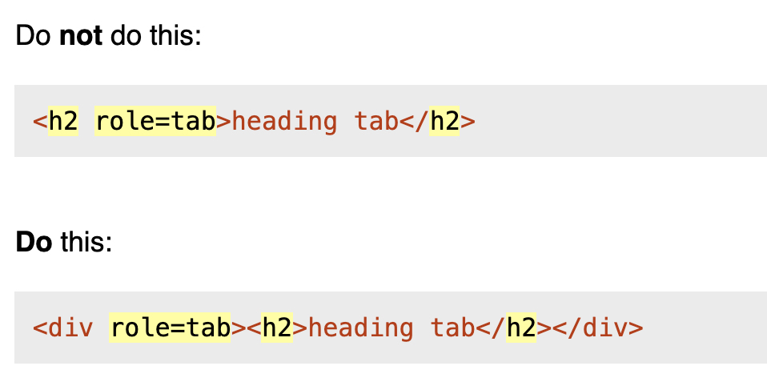
W3C Aria Rules
Rule 1 - If you can use a native HTML element or attribute with the semantics and behaviour you require already built in, instead of repurposing an element and adding an ARIA role, state or property to make it accessible, then do so.
Only break rule if no accessibility support or it cannot be styled or if feature not currently available in HTML
Rule 2- Do not change native semantics

Slide 25
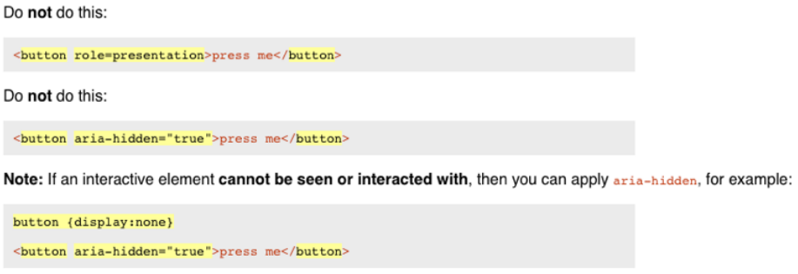
W3C Aria Rules
Rule 3 - all interactive ARIA elements must be usable by the keyboard
Say your site contains a widget that user can interact with - then user should also be able to tab to it and use it with the keyboard
Rule 4 - Do not use role=“presentation” or ariahidden=“true” on a visible focusable element

Slide 26
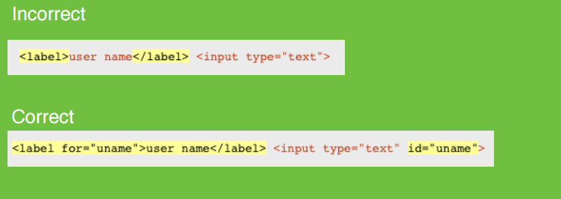
W3C Aria Rules
Rule 5 - All interactive elements must have an accessible name

Slide 27
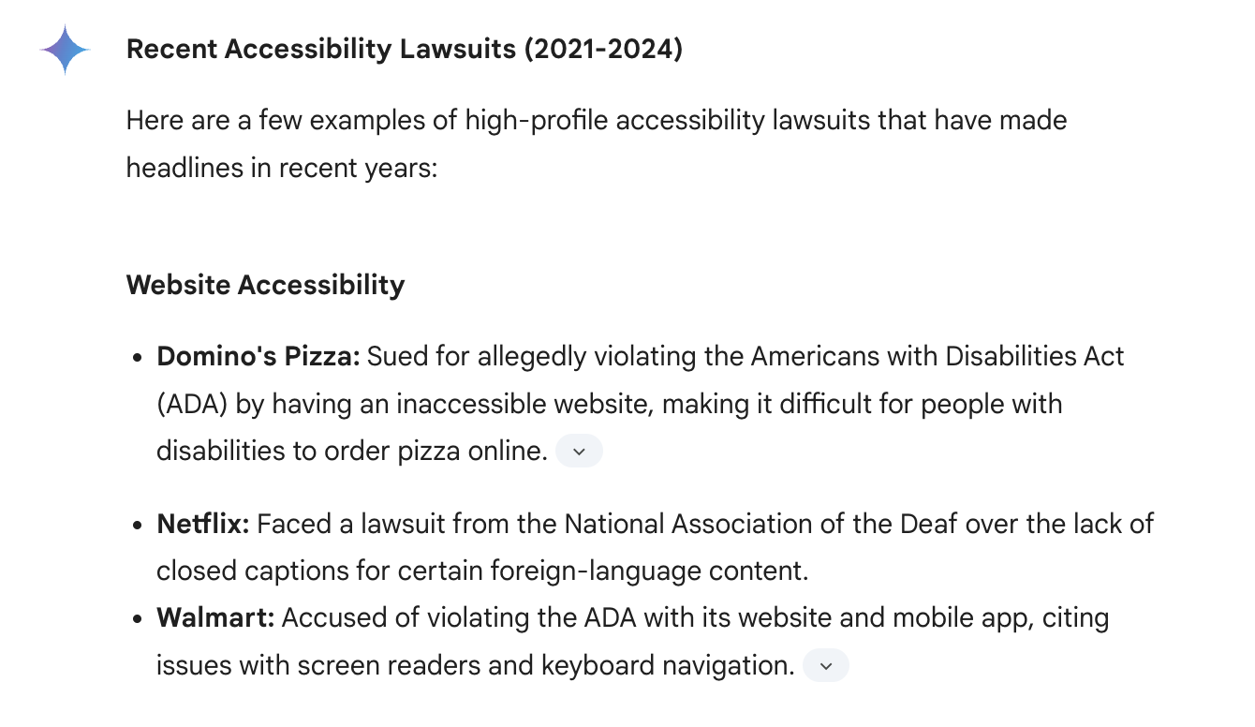
Examples of recent accessibility lawsuits*
*sourced via Gemini

Slide 28
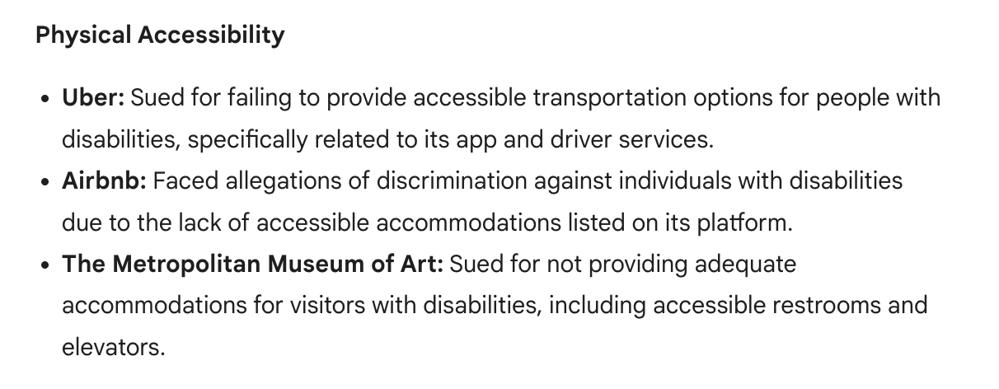
Examples of recent accessibility lawsuits*
*sourced via Gemini

Slide 29
Useful links
Inclusive Design
Universal Design
2018 Accessibillity Lawsuits
Why accessible design makes good business sense (Medium.com)
Concise short guide to ARIA roles and attributes
Checkmycolours.com
Contrast checker

